Slide 1

dfm_tools
A Python package for D-FlowFM input and output
Jelmer Veenstra
Naam Achternaam

Slide 2






dfm_tools: the concept
What:
Python package for pre- and postprocessing D-FlowFM input and output files
convenience functions built on top of other packages like xarray, hydolib-core and more
features: https://github.com/openearth/dfm_tools#features
Why:
sharing of workflows among users (colleagues/external)
no need to reinvent the wheel
developments driven by projects like hydrolib-core, MassBay, FutureMares, TCOMS
Where:
code on github: https://github.com/openearth/dfm_tools
installable via pip: https://github.com/openearth/dfm_tools#installation

Slide 3
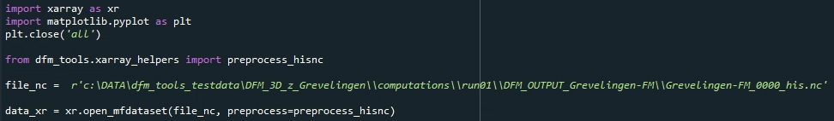
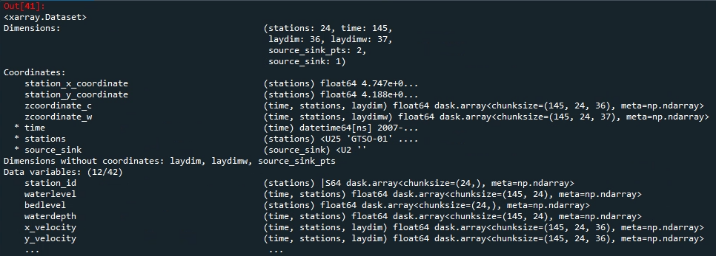
xarray: io of netcdf files
lazy loading of netcdf files with knowledge of the entire structure
easy indexing over all dimensions with .isel() and .sel()
preprocess_his() enables indexing via station names (and other labels)

Slide 4
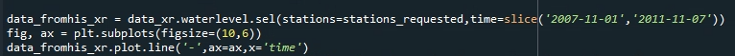
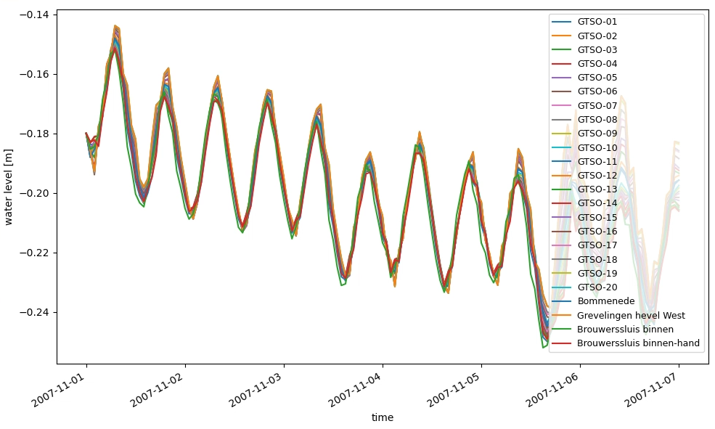
xarray: io of netcdf files
easy indexing (subsetting)
easy and complete plotting
.../tests/examples/postprocess_hisnc.py

Slide 5

HYDROLIB: io of D-FlowFM input files
Core scripts & tools for interaction with D-FlowFM:
reading/writing of (almost all) D-FlowFM input files (mdu, ext, bc, pli, etc)
full functionalities: https://deltares.github.io/HYDROLIB-core/0.3.1/topics/dhydro_support/
supported, documented, maintained
available on github: https://github.com/Deltares/HYDROLIB-core
users do not need to re-invent the wheel about “basic stuff/file formats”, focus on the analysis itself

Slide 6
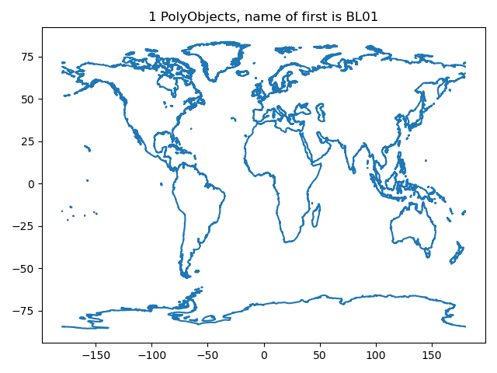
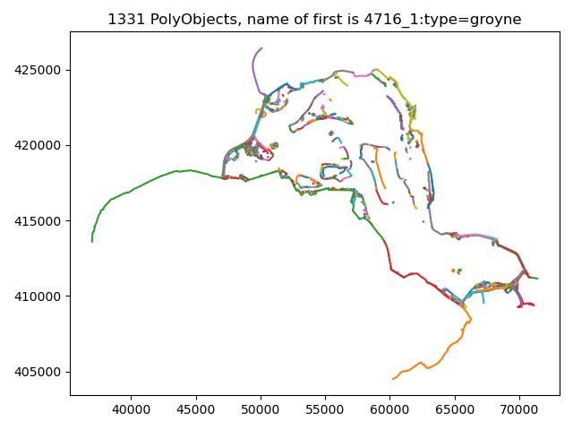
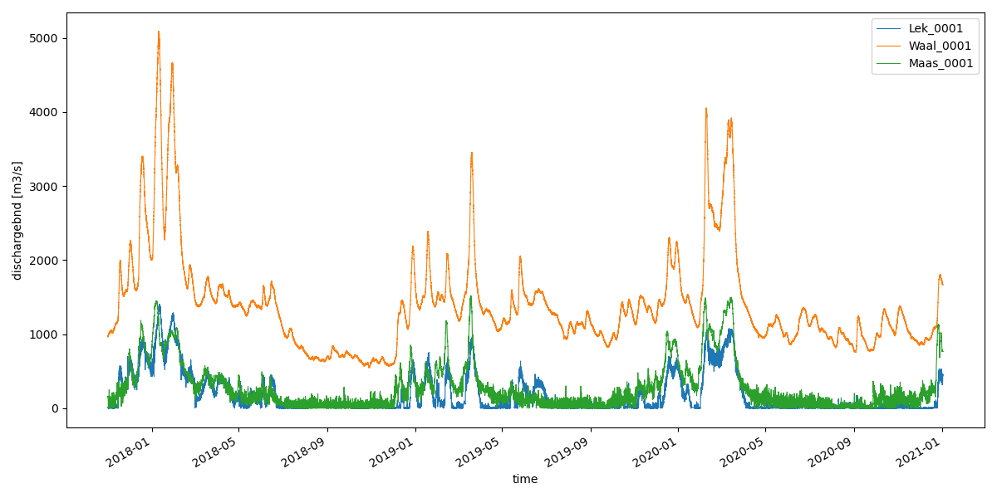
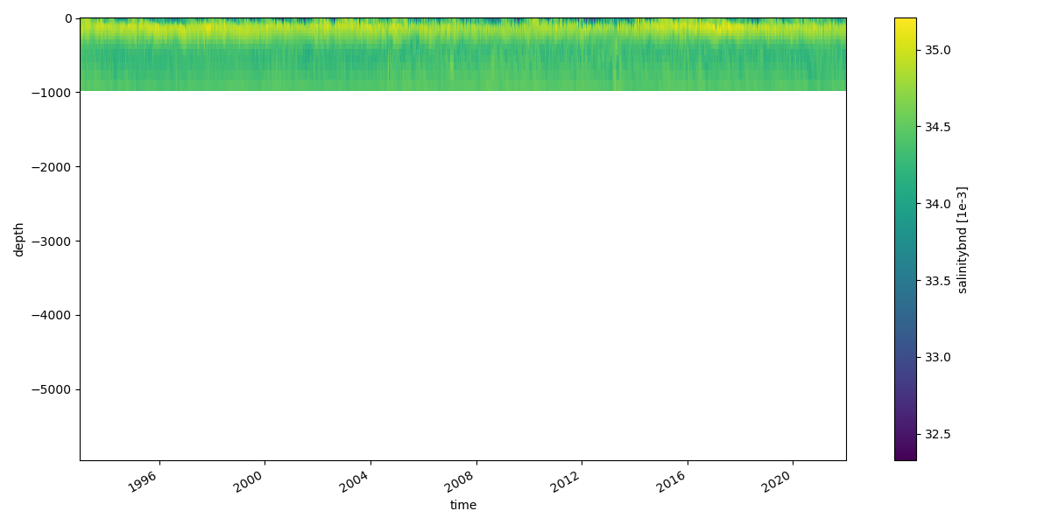
Examples: reading+plotting of D-FlowFM input files
hydrolib for reading files
conversion to xarray dataset
pli/pliz/ldb/tek (global, Grevelingen)
bc (T3D salinity, bc (TimeSeries discharge)
.../tests/examples/preprocess_hydrolib_readbc.py
.../tests/examples/preprocess_hydrolib_readwritepol.py

Slide 7
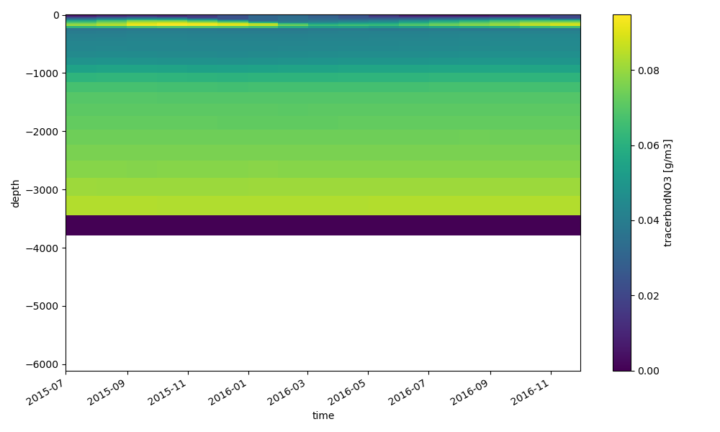
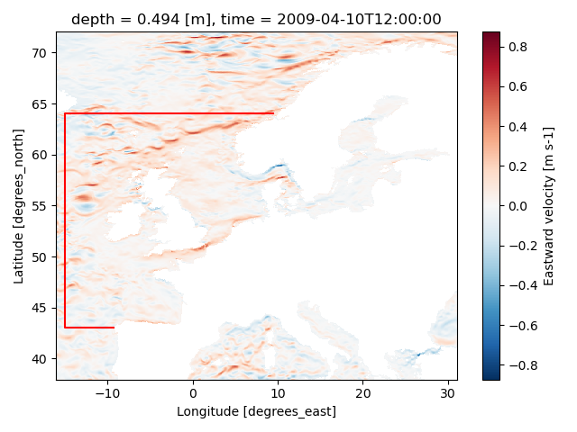
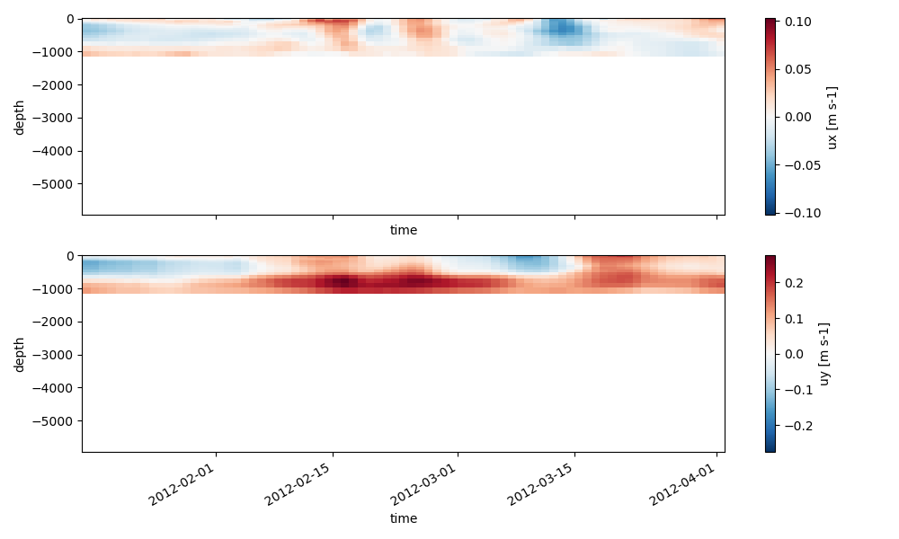
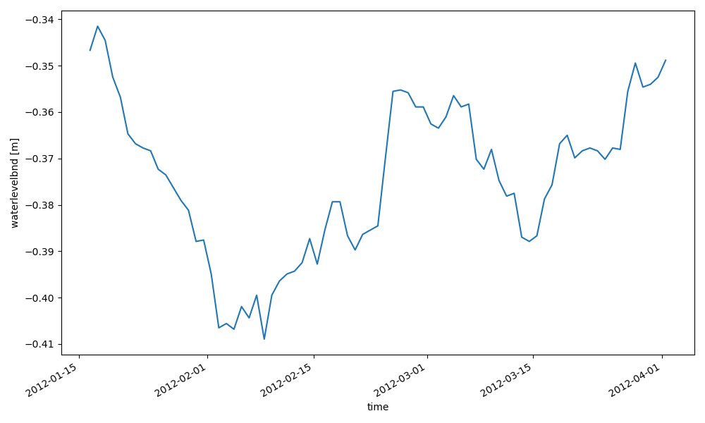
Examples: interpolate oceanmodel to bc
xarray for reading netcdf data and .interp() to polyline points
hydrolib for writing bc/ext and model structure
.../tests/examples/preprocess_interpolate_nc_to_bc.py

Slide 8
Application for regional models
Manually defined model boundaries, used for:
Grid cut-out of GTSM (currently manual)
Download of ERA5 and CMEMS field
.../tests/examples/download_meteodata_oceandata.py
Generation of (2D) open boundary forcing from FES2014 (tidal constituents)
.../tests/examples/preprocess_interpolate_nc_to_bc.py
Generation of (3D) open boundary forcing from CMEMS (salinity, temperature and sealevel anomaly)
.../tests/examples/preprocess_interpolate_nc_to_bc.py
Generation of 3D initial fields from CMEMS (salinity and temperature)
.../tests/examples/preprocess_ini_cmems_to_nc.py
Generation of meteorological forcing fields
.../tests/examples/preprocess_meteo_mergenetCDFtime_xarray.py
The dfm_tools enables the quick set-up of the basis of a 3D model

Slide 9
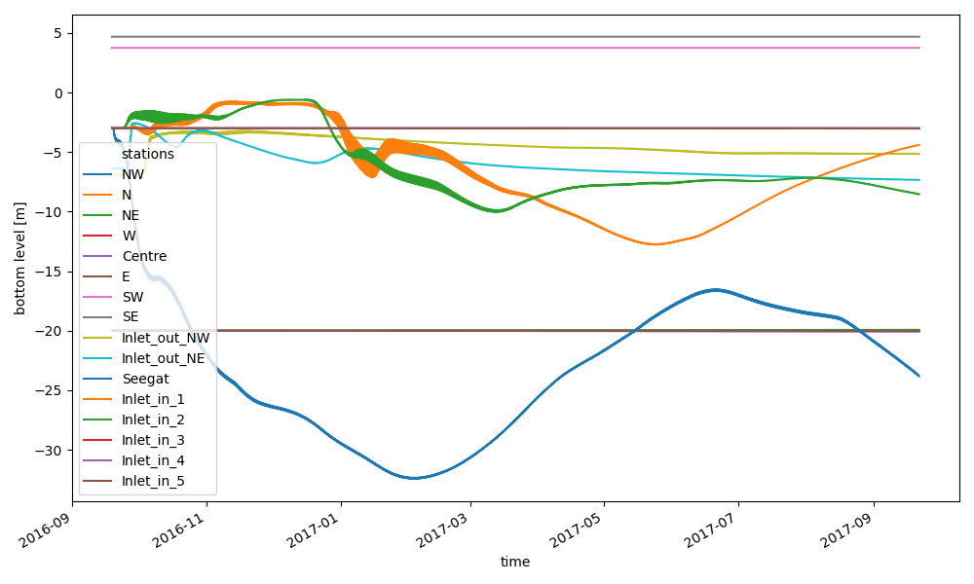
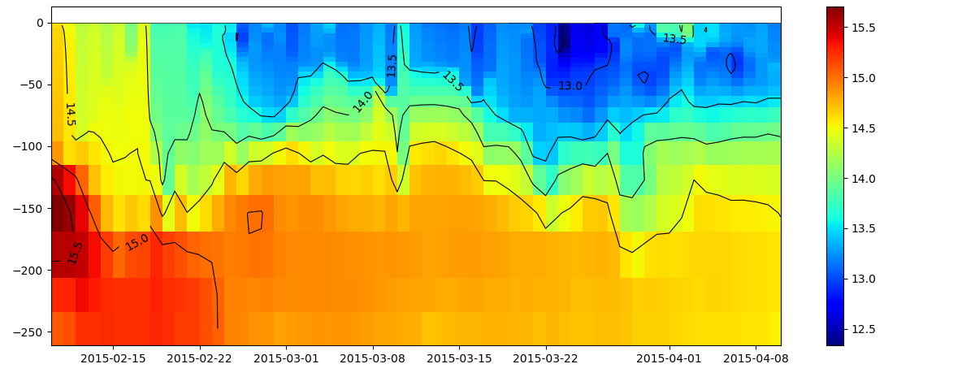
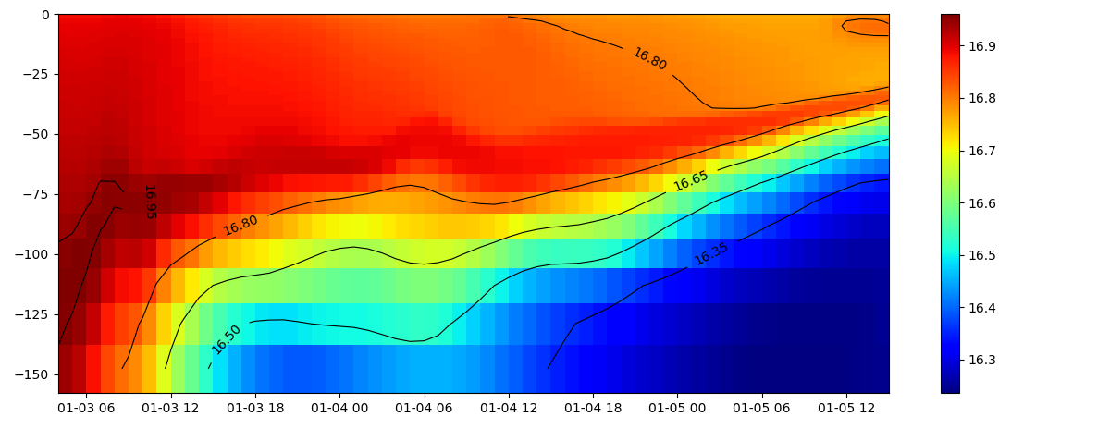
Examples: read+plot hisfile
xarray for reading hisfile (D-FlowFM and sfincs)
selection of data over dimensions: time, depth, stations, cross_sections, structures, etc
zt-plot (timeseries of one point with depth dim)
.../tests/examples/postprocess_hisnc.py
coming up:
interpolation
nesting

Slide 10
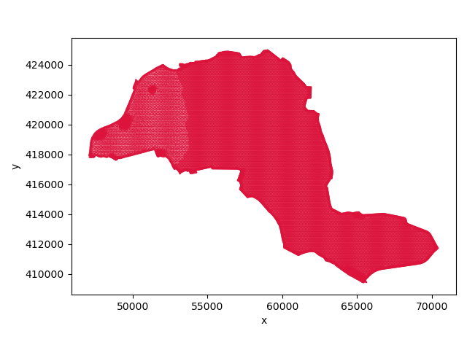
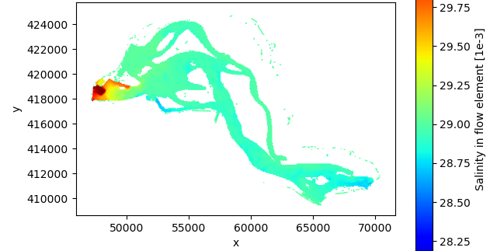
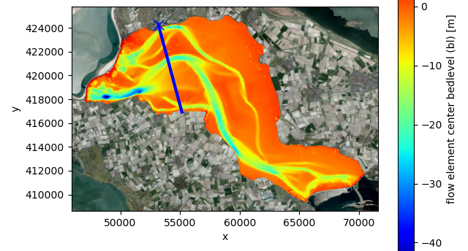
Examples: read+plot mapfiles
supports flexible meshes (unstructured) map/fou/rst/net
supports partitions (and handles ghost cells)
will be converted to xarray for more convenience/performance
3D slicing: next slide

Slide 11
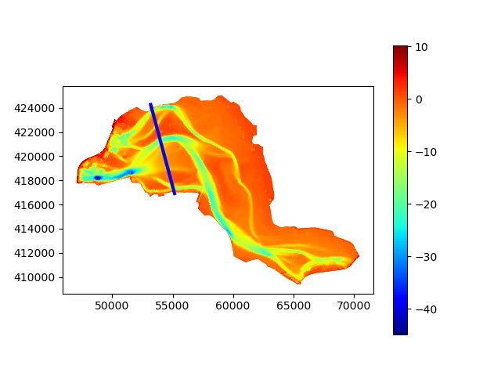
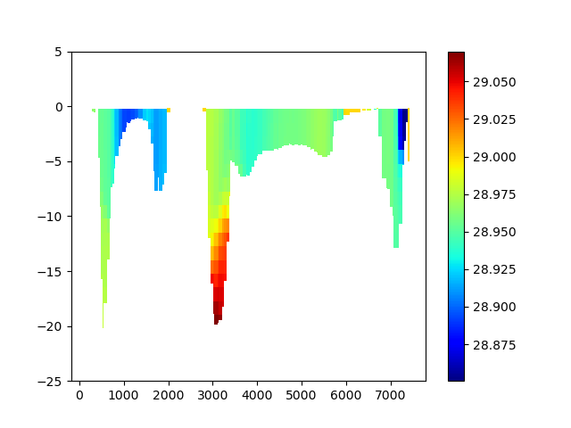
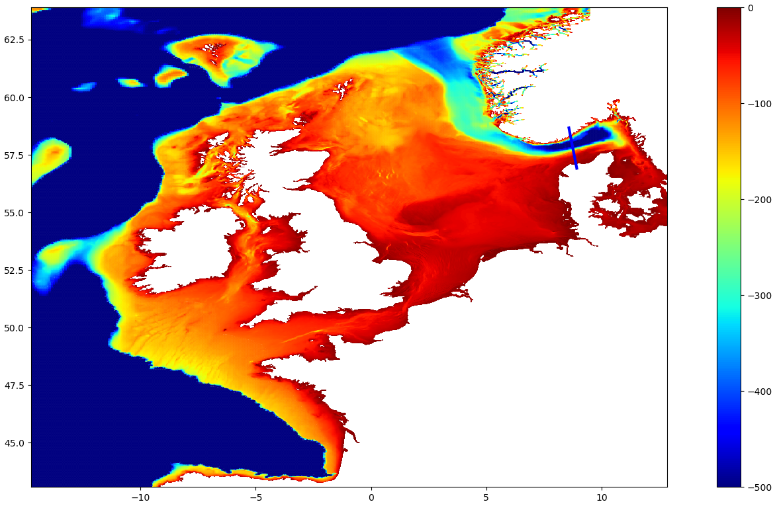
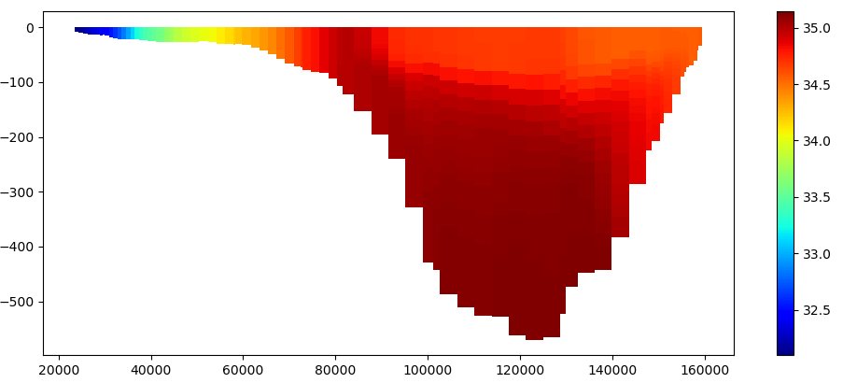
Examples: slice trough 3D partitioned FM map data
given a polyline (blue)
slice trough 3D partitioned FM map data

Slide 12
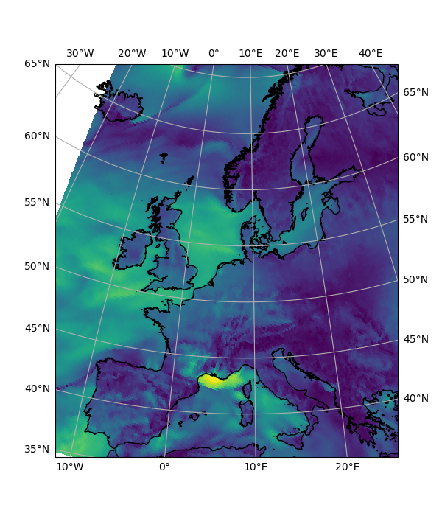
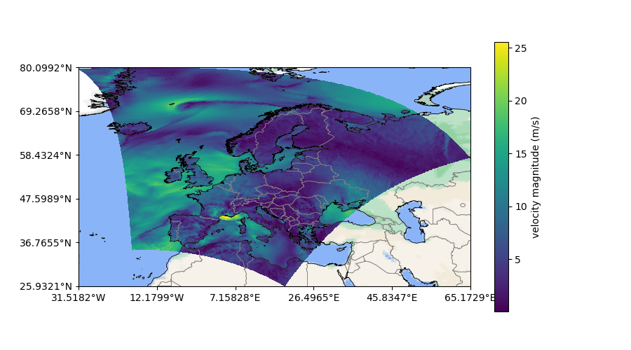
Examples: cartopy basemaps and coastlines/borders
support for almost any epsg

Slide 13
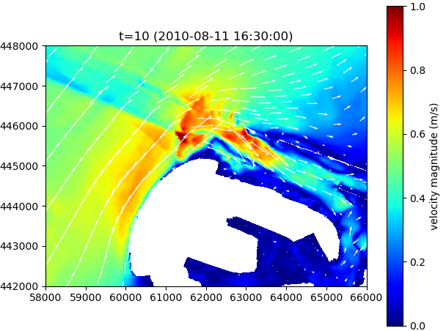
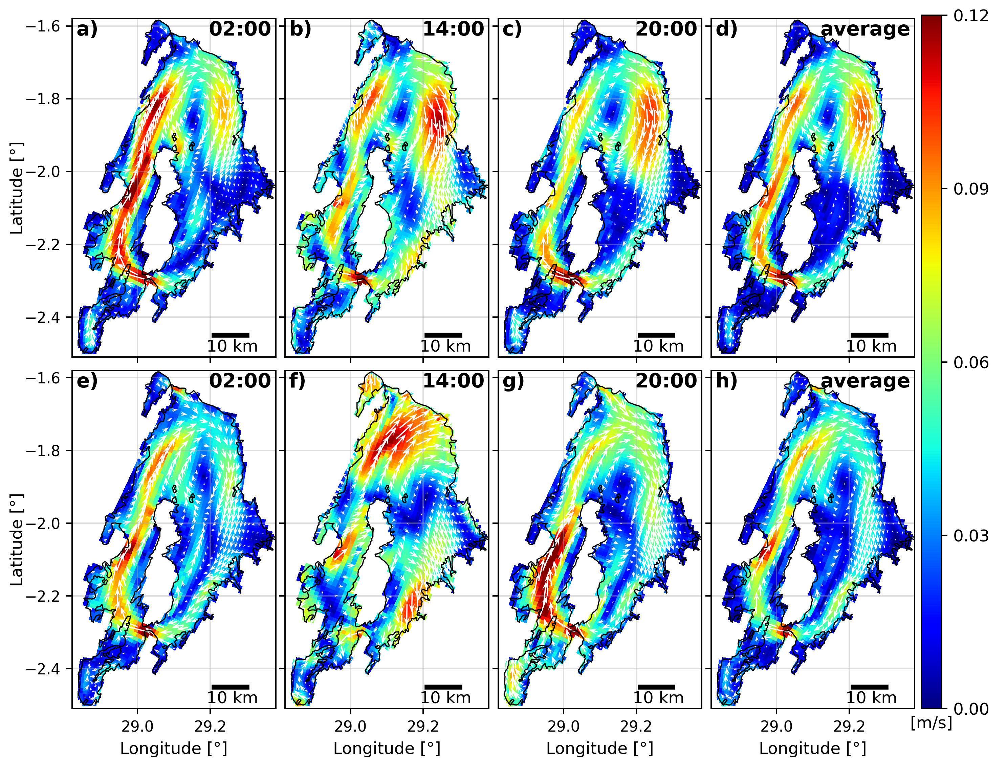
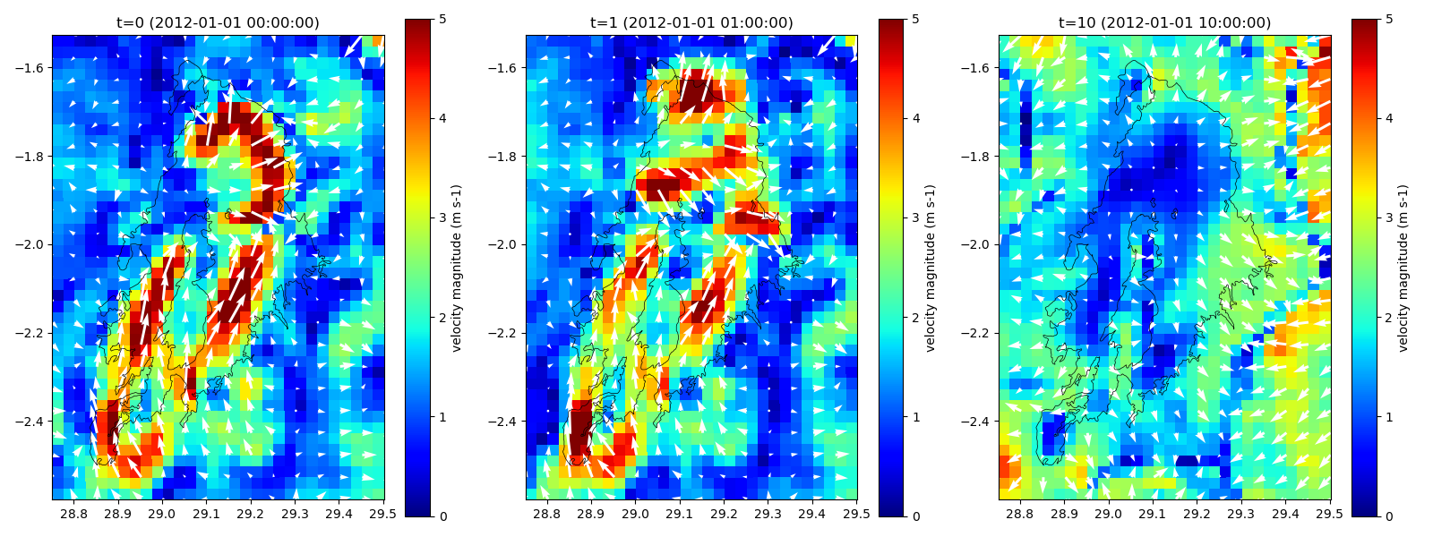
Examples: vector plots for regulargrids
SFINCS, Delft3D4, oceanmodels, meteomodels

Slide 14
Next steps
uitbreiding/improvements:
support for D3D4?
extra models/sources for download/interpolate (evt xESMF for CMCC and others)
gebruikerswensen intern/rws/overig
afstemmen overlap hydromt ea
improvement of reading D-FlowFM mapdata (move to xarray and maybe xugrid, but mind partitions)
voorbeelden toevoegen:
ini field uit 2D/3D map/rst
monthly/daily means or depth average of his/map fields
nesting biesbosch toevoegen
nesting rmm/tcoms (interpolate map to obs/plipoints) (simple wl and z/sigma to z?) (400sec TK?)
nesting FM in FM? (invdist interpolate his to obs/plipoints)
Example notebook C-scale: https://github.com/c-scale-community/use-case-hisea/blob/main/notebooks/visualise_delft3dfm.ipynb

